Slide 1


Studio: VR/AR x Education
Team 2
Language Immersion In VR

Slide 2


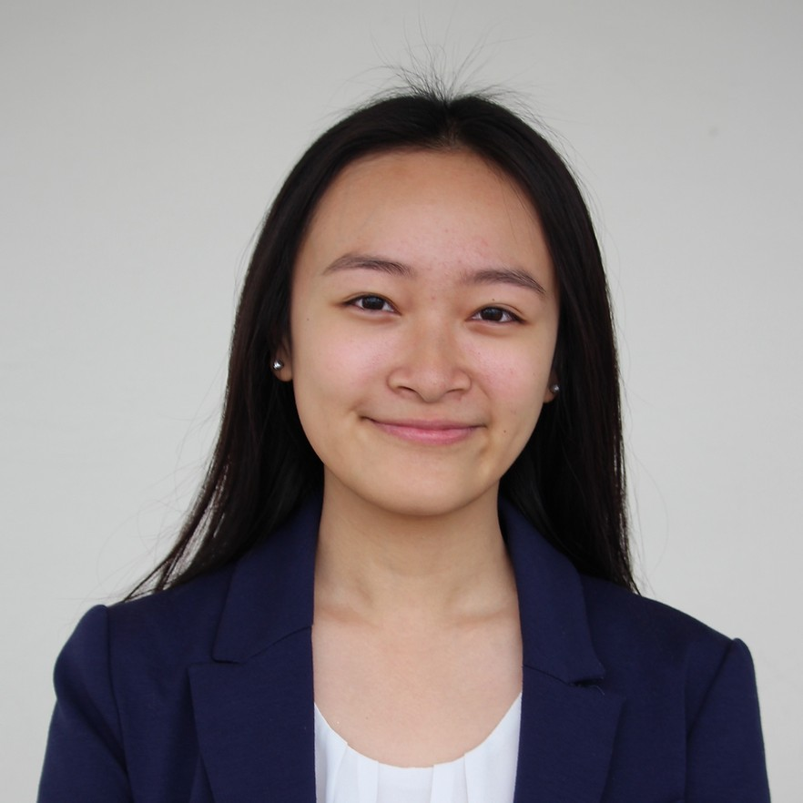
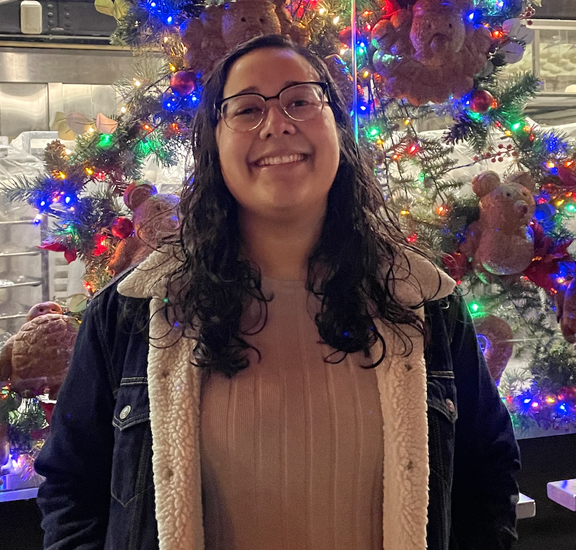
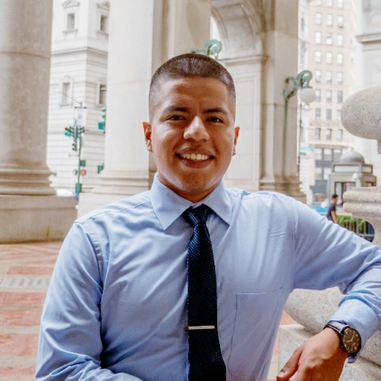
Team Members
Langu
(they/them)
Amanda
Anna
Selaine
Wilmer

Slide 3



Overview
Mission Statement
Presentation Milestones
Interface +
Rational
Low-Fi Prototype
Task Flows
Method
Results
UI Changes
Summary

Slide 4
Team Mission Statement/Value Proposition
Create an encouraging and immersive language-learning environment for all.

Slide 5


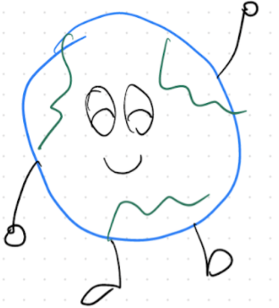
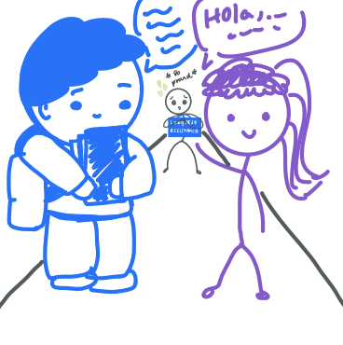
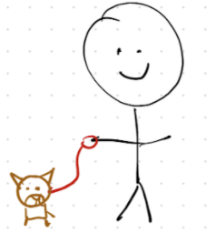
Interface + Rationale
Figma

Slide 6


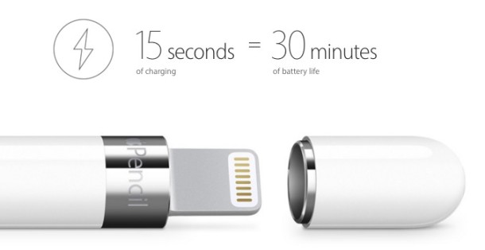
Honorable Mentions
Zoom, Notability, Apple Pencil

Slide 7
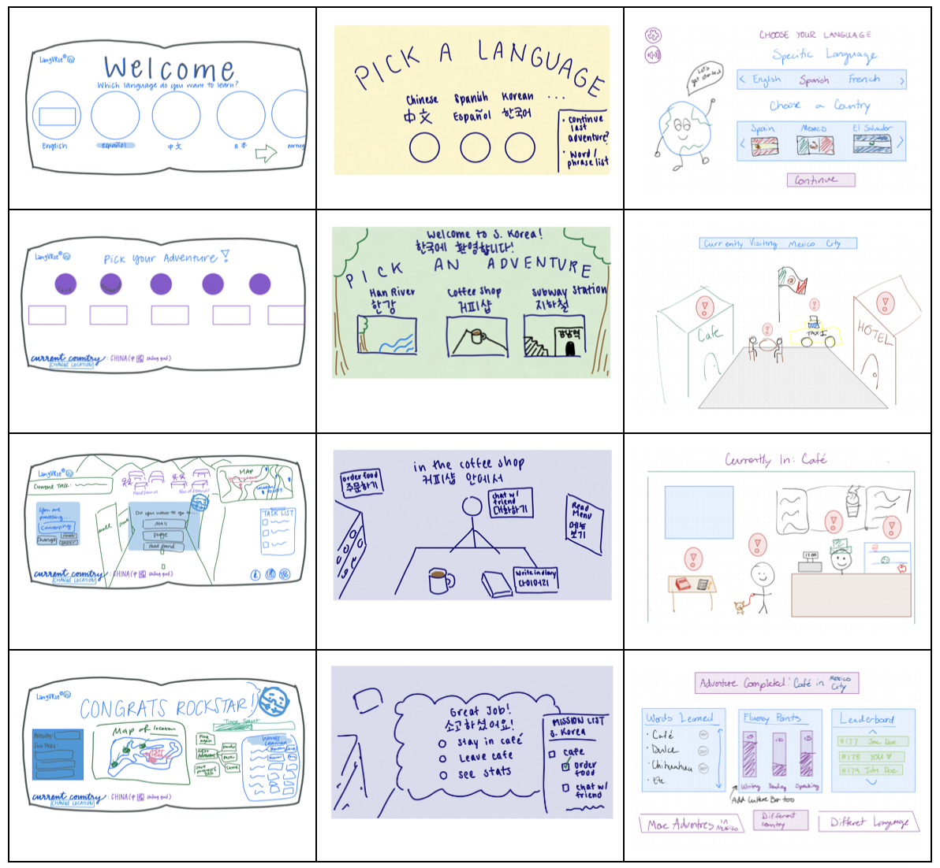
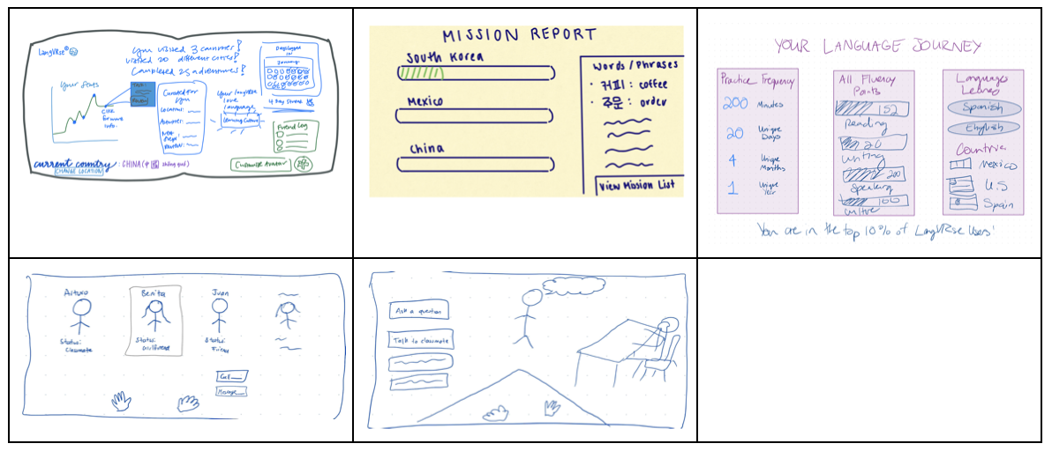
Concept Sketches
Crazy 8’s Workflows

Slide 8
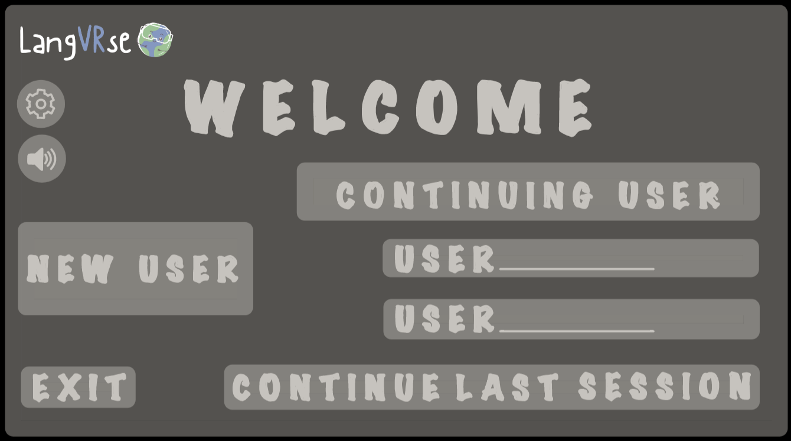
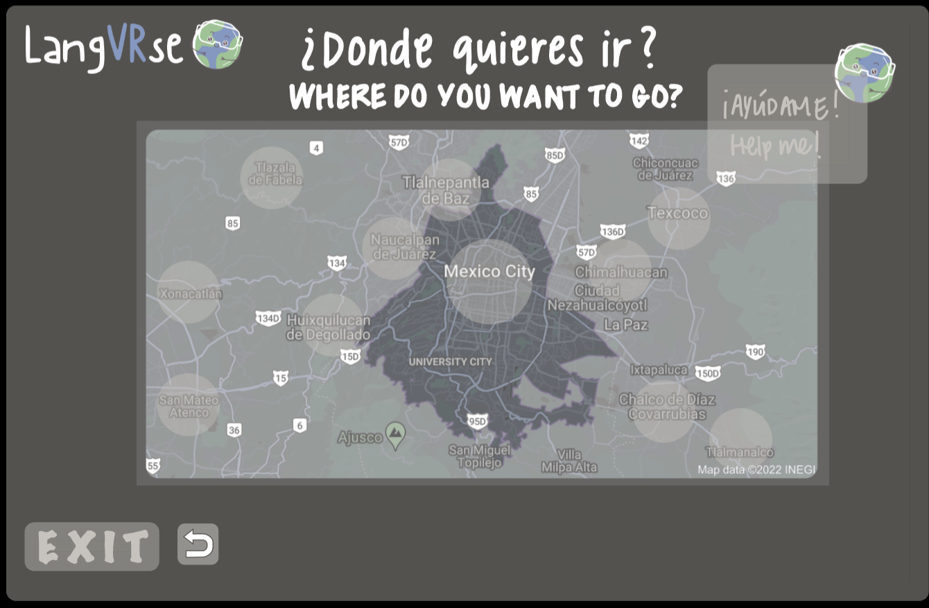
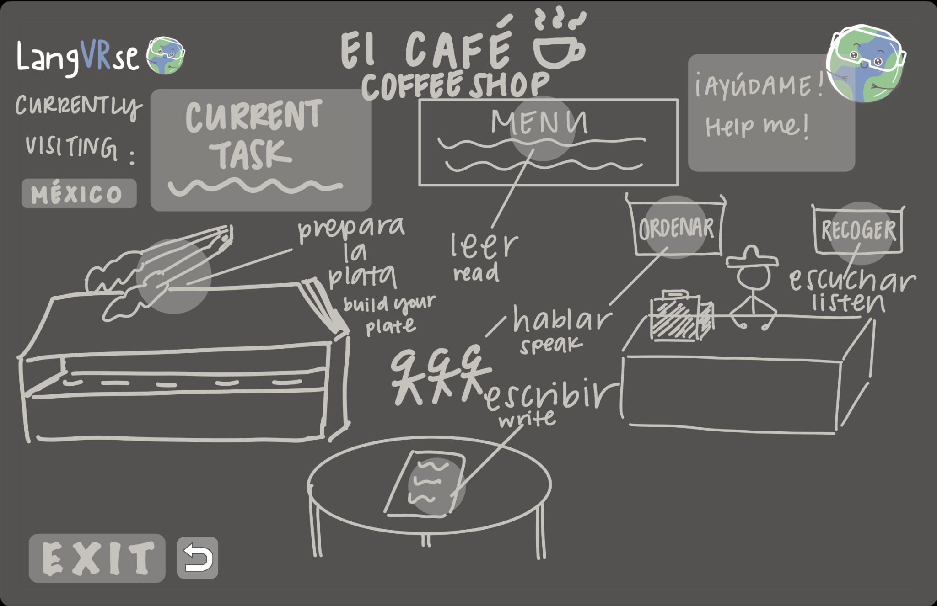

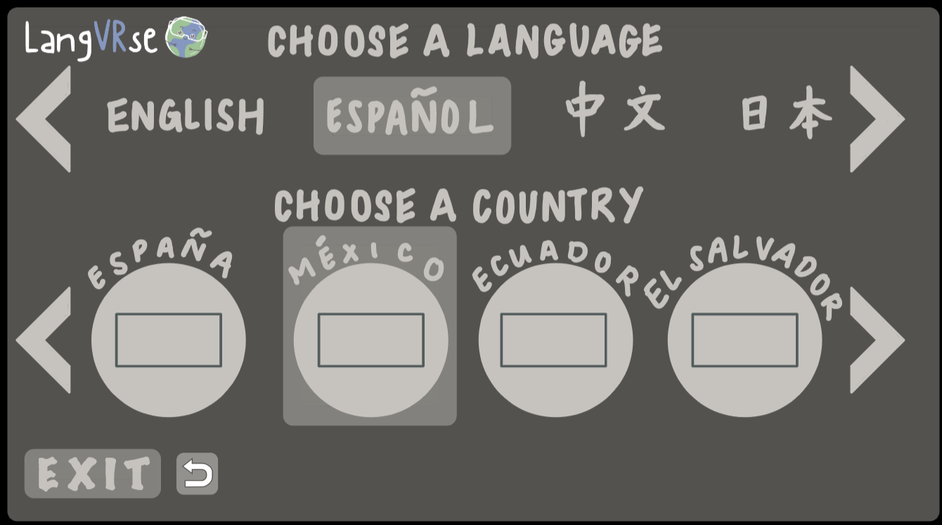
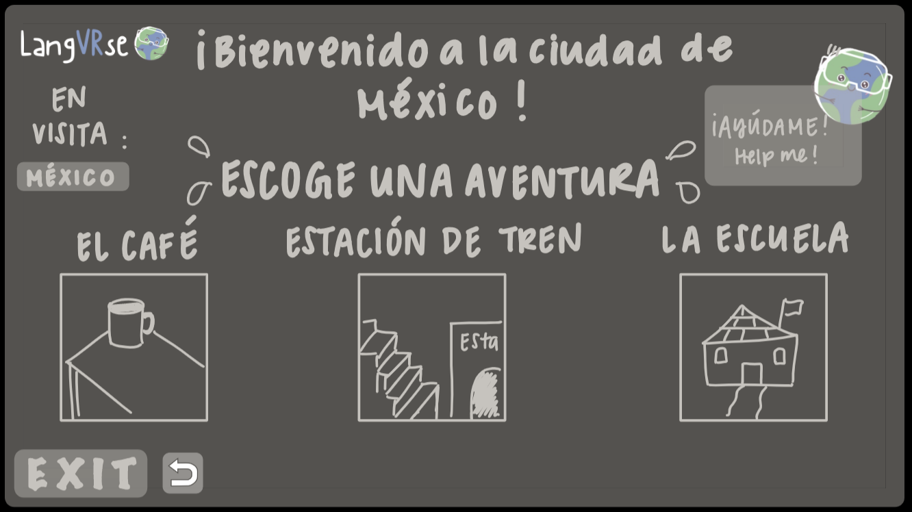
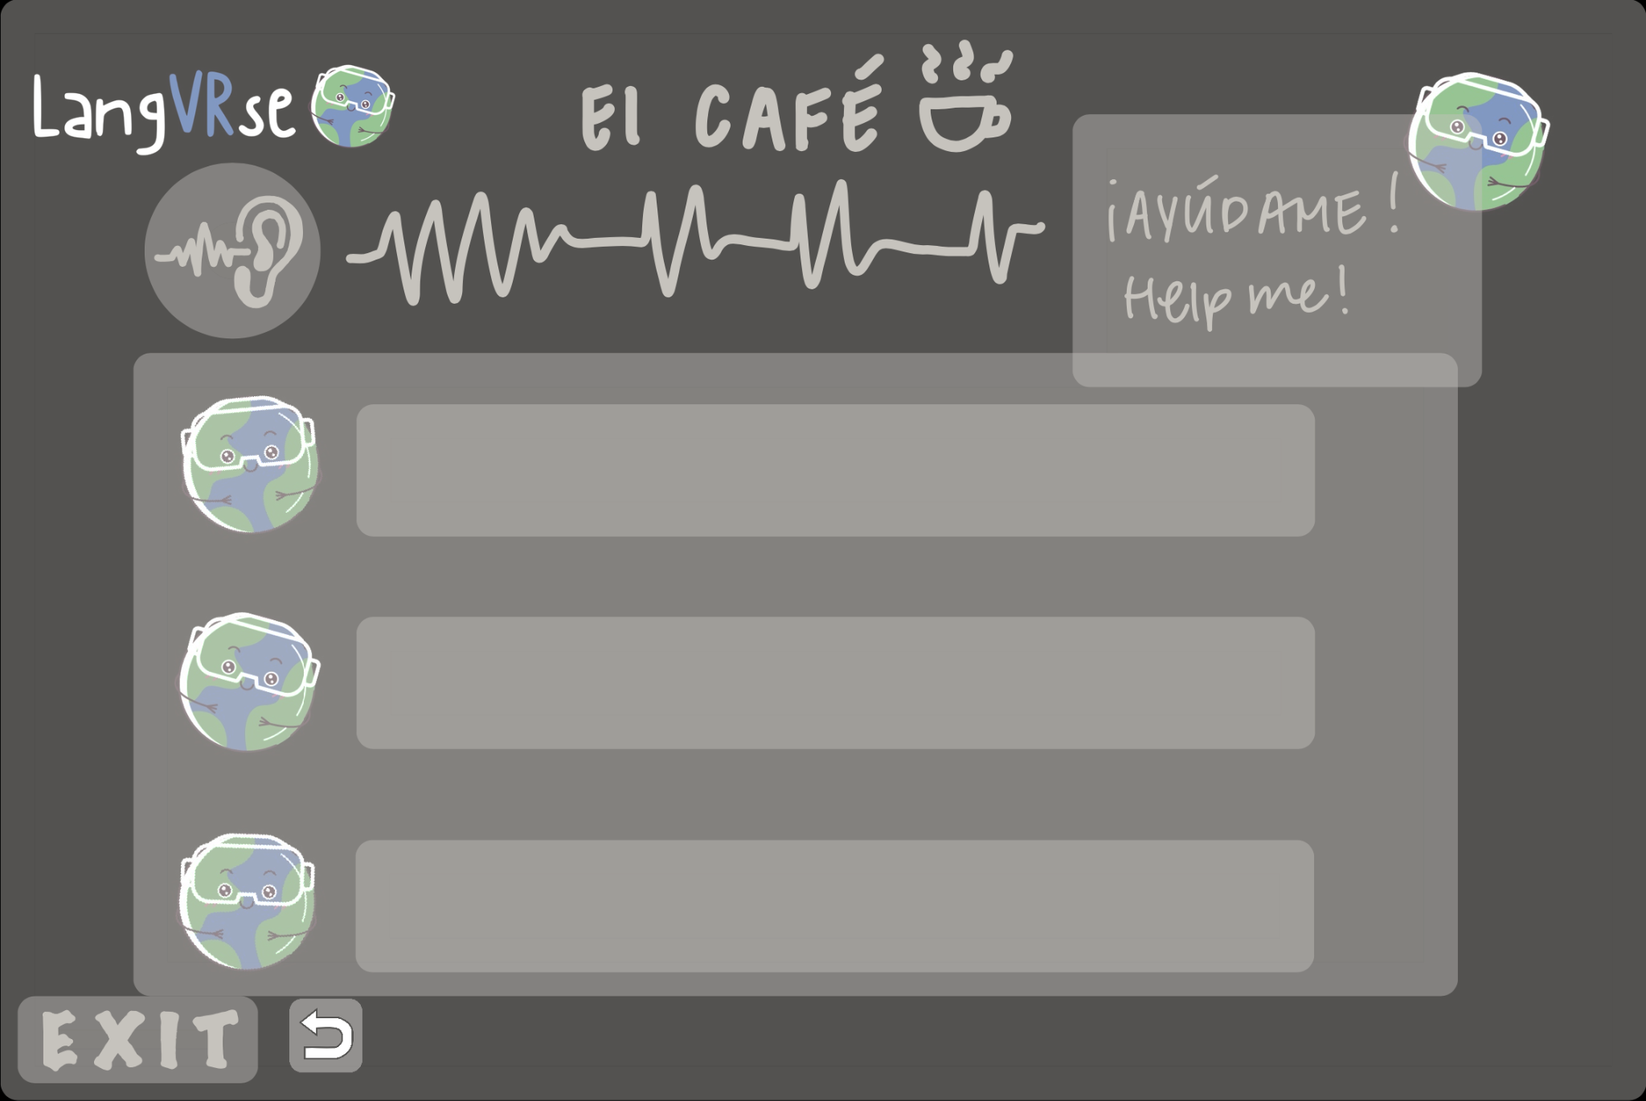

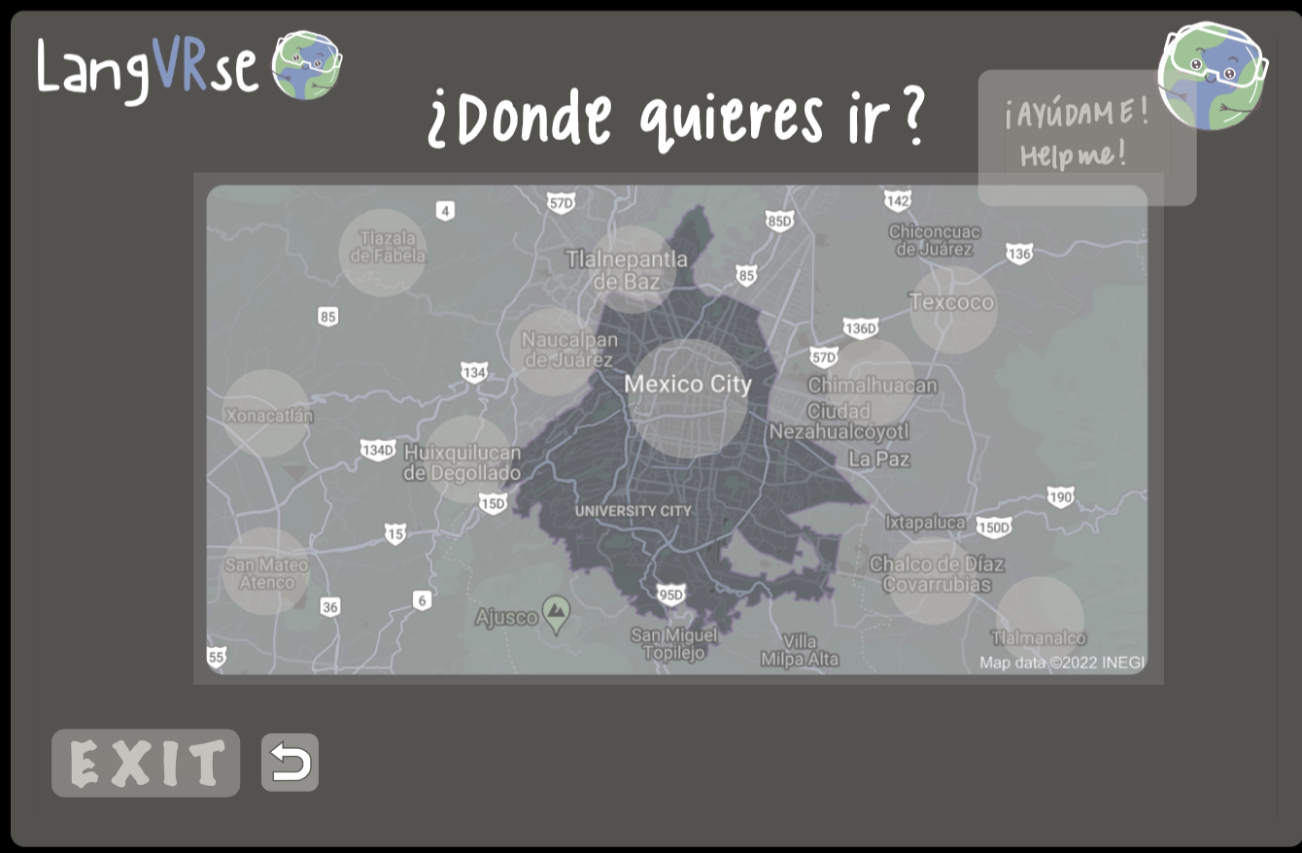
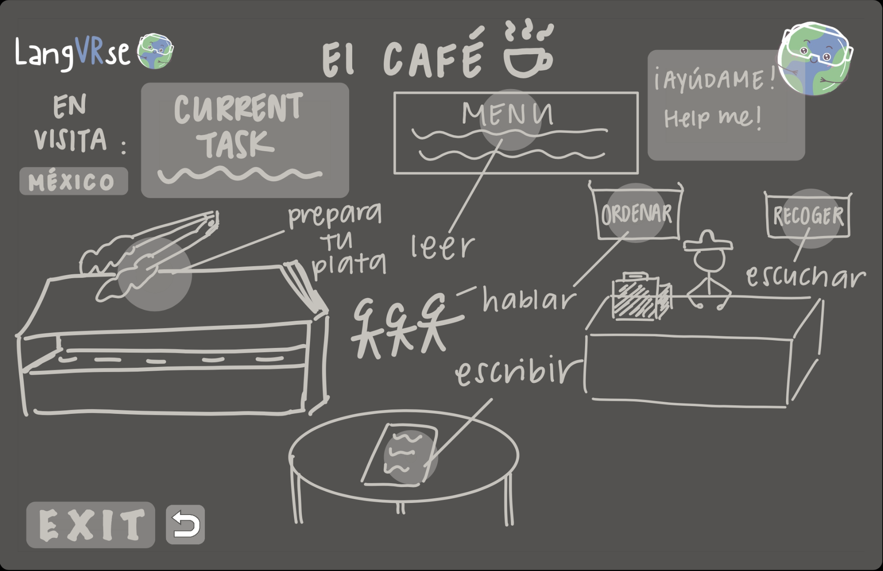
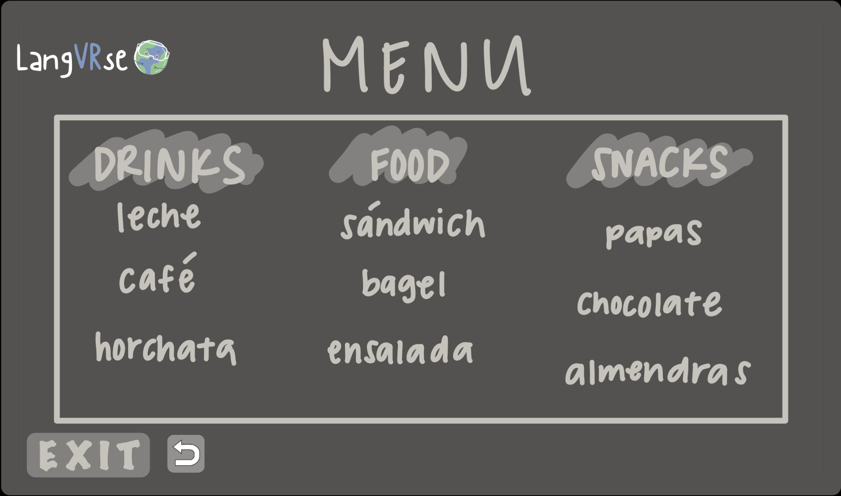

Low-Fi Prototype

Slide 9
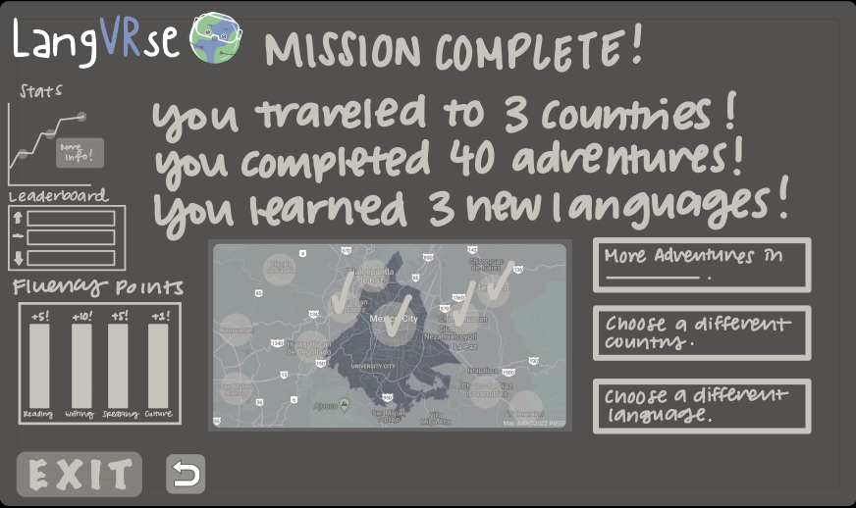
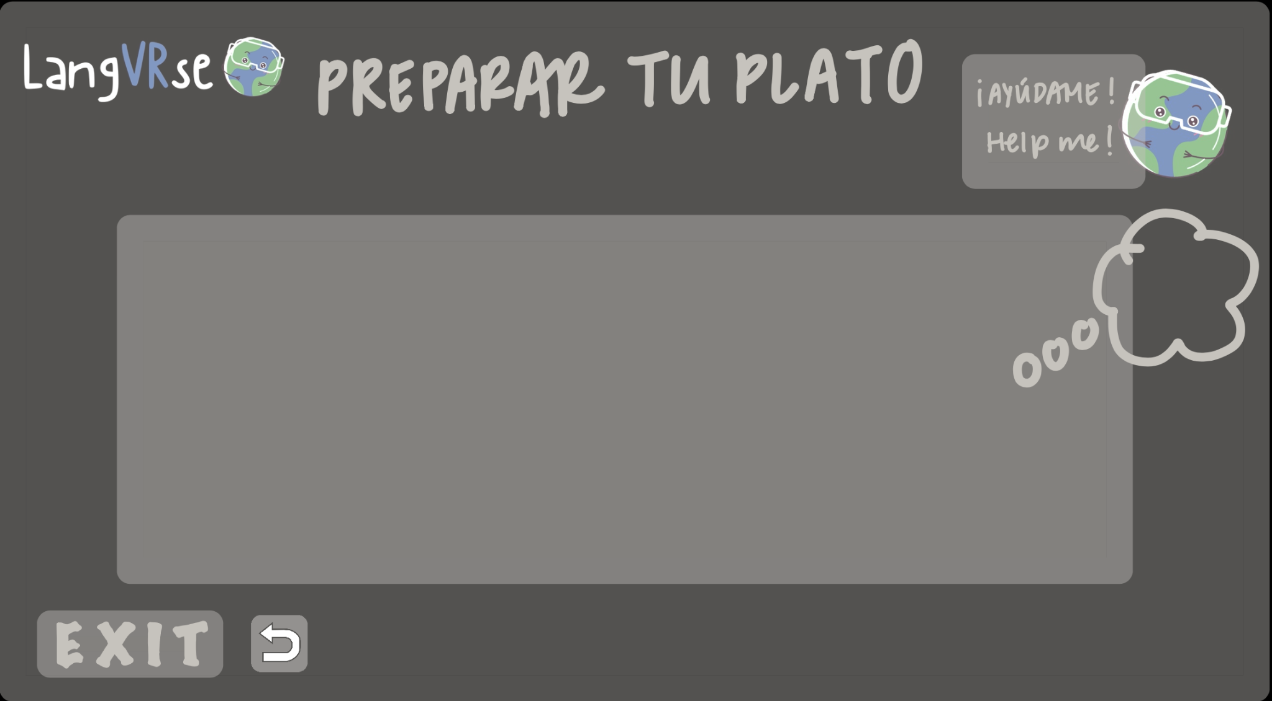
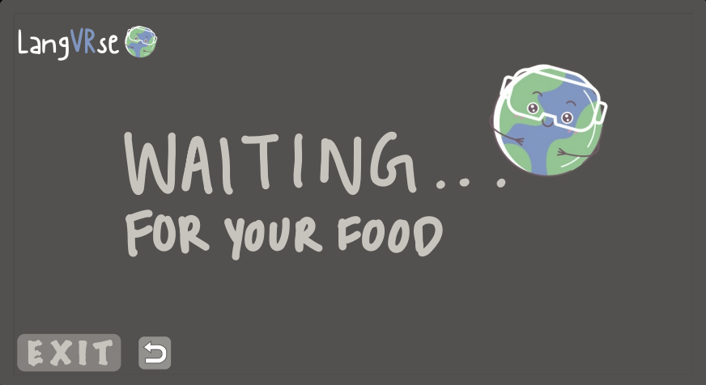
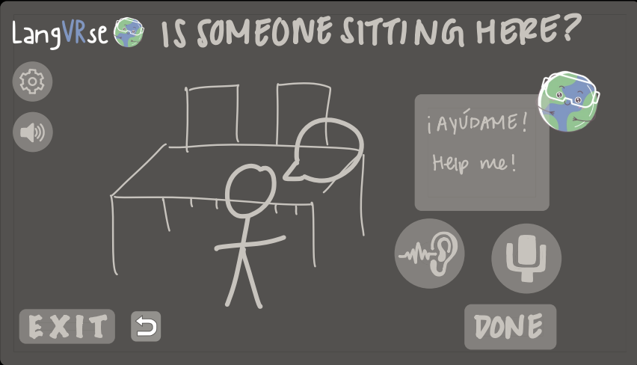

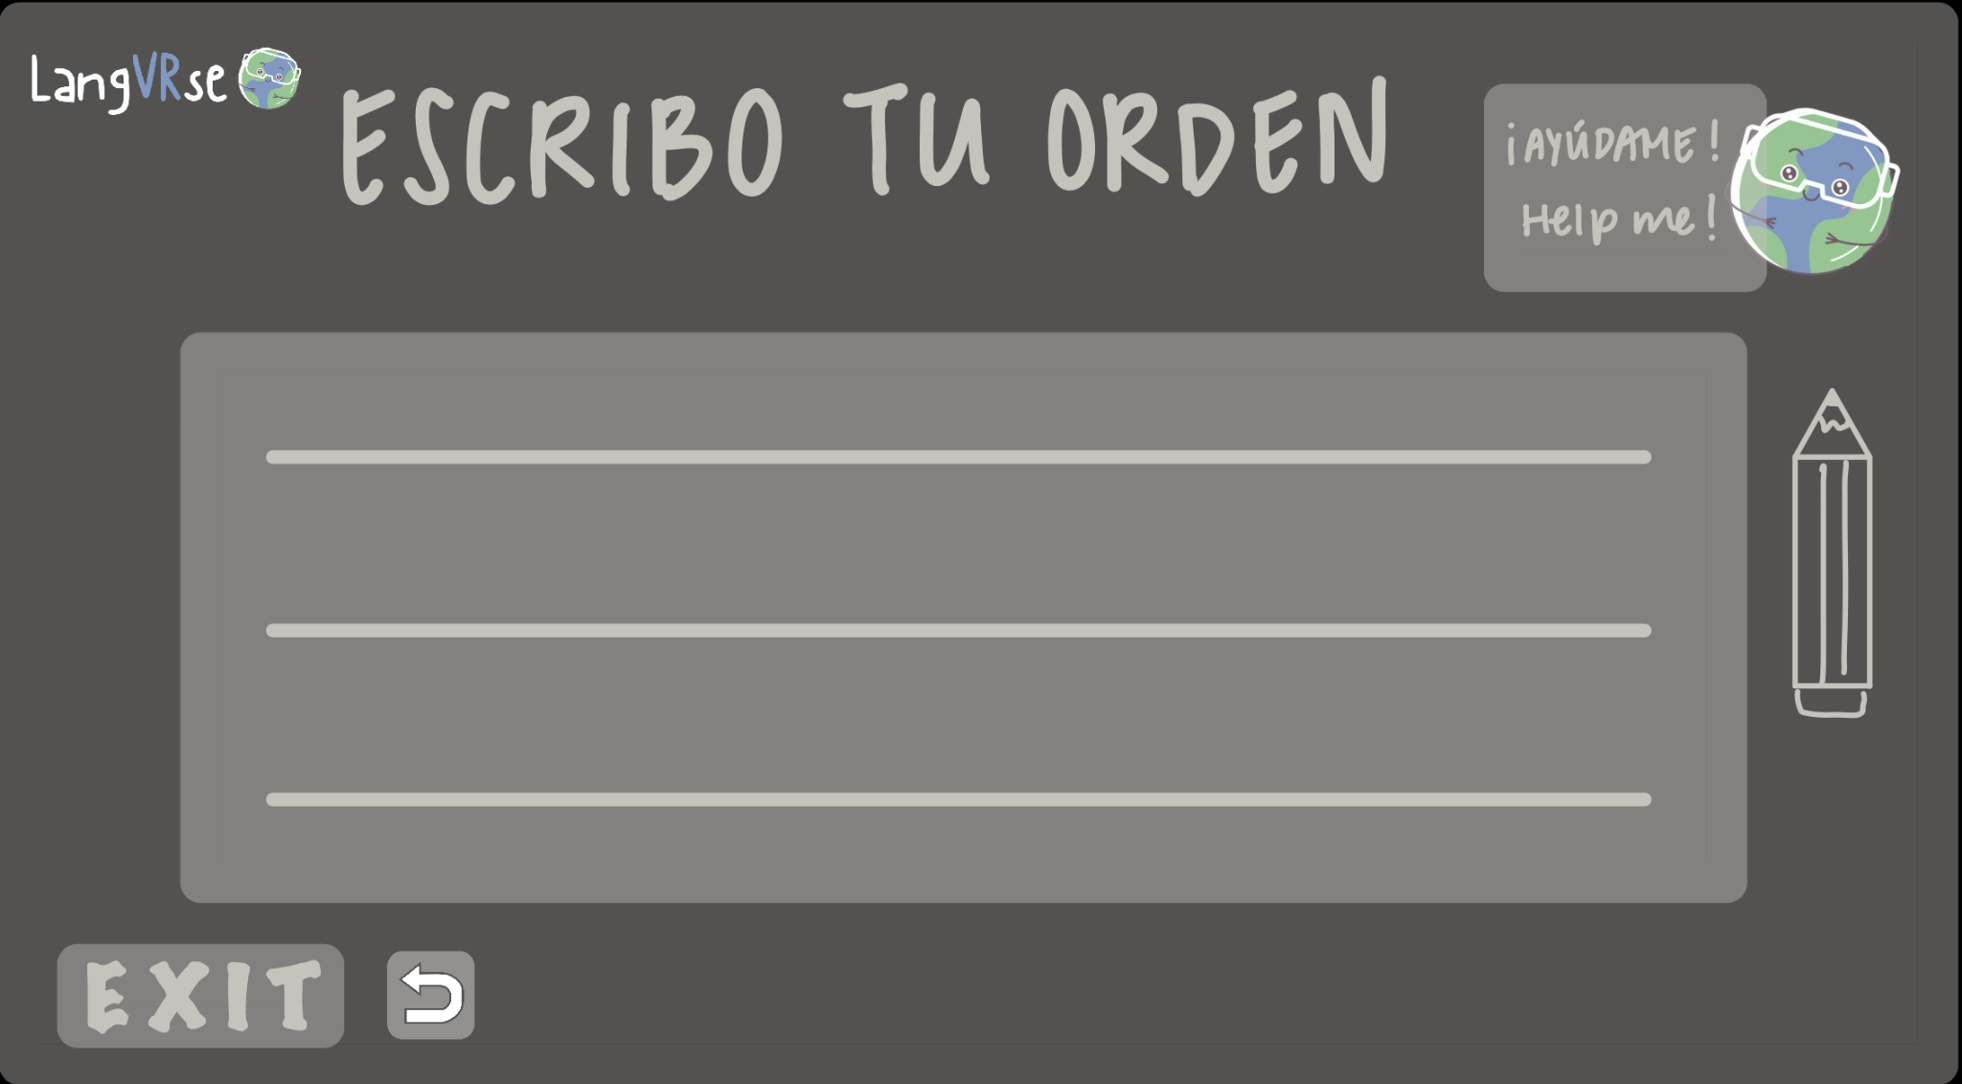
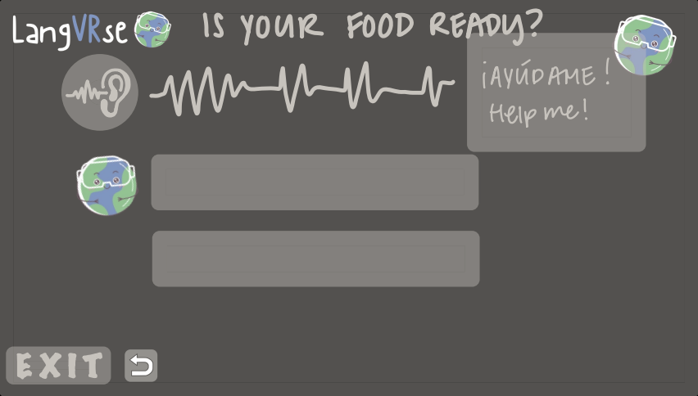
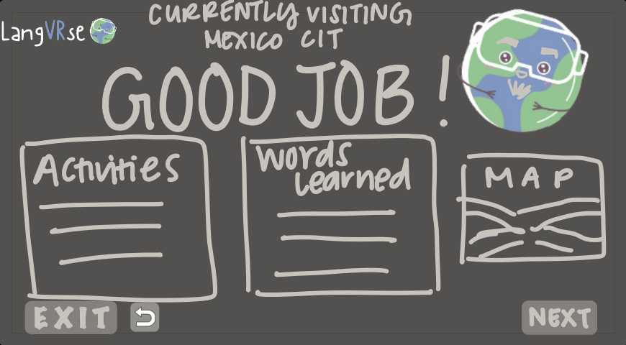
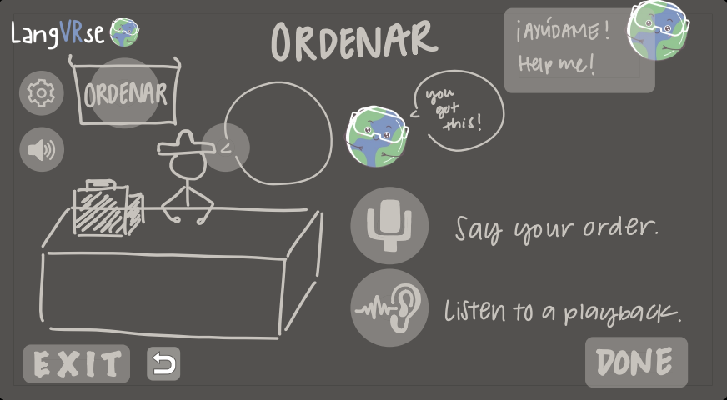

Low-Fi Prototype

Slide 10
Tasks & Task Flows
Task 1 (Simple): Comprehend simple phrases in a language of interest. (understand)
Task 2 (Moderate): Be able to read and write common statements (name, introduction, etc.). (produce)
Task 3 (Complex): Be able to answer questions and follow instructions (without context clues). (engage)

Slide 11
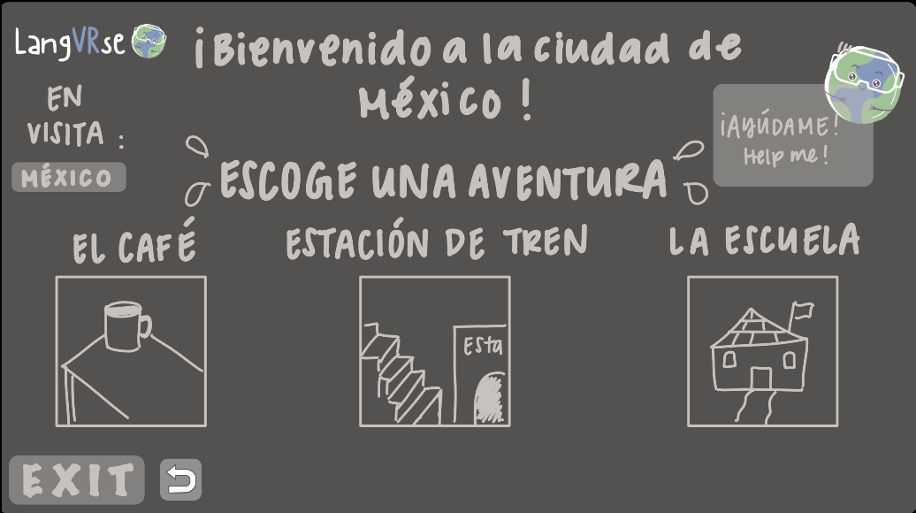

Simple Task
Understand: “Comprehend simple phrases in a language of interest.”

Slide 12
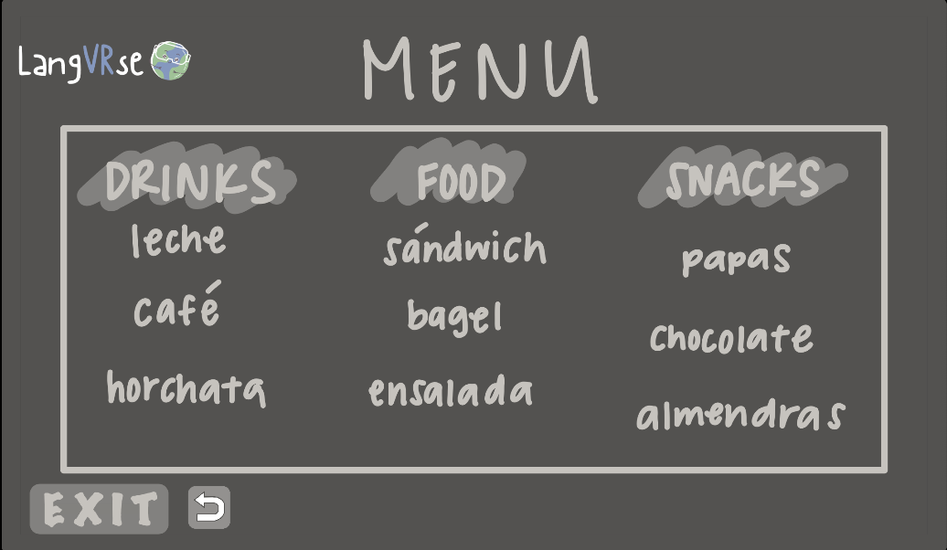

Produce: “Be able to read and write common statements (name, introduction, etc.).”
Moderate Task

Slide 13
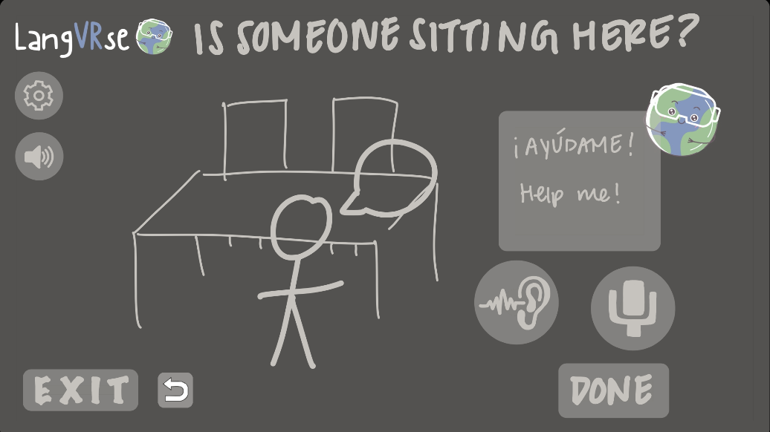

Complex Task
Engage: “Be able to answer questions and follow instructions (without context clues).”

Slide 14
User #1
🧒
10-year old 4th grade student who attends a bilingual elementary school
Prototype Usability Testers
User #2
👩
18-year old senior in high school who learned a new language at the age of 15
User #3
👴
75-year old retired taxi driver, scholarship chair and current community activist and educator who is monolingual

Slide 15
Experimental Method
Figma
Click for navigation
Interactivity-oriented
Aloud thinking
Post-experience follow-up

Slide 16

🧒
Experimental Results: User #1
“I really liked the settings [the cafe experience] that you played the game in”

Slide 17

👩
Experimental Results: User #2
“ It was fun looking at the menu and thinking about of what to order, like in real life situations…I think maybe waiting in line and starting conversations with strangers like what conversation starters are like can be cool”

Slide 18

👴
Experimental Results: User #3
“...limit the choices on ordering and serving and other things. You can have a person in the restaurant who responds to the choices of the people. And the responses can be variations of ‘very good’”

Slide 19


More Pictures of the Country/Location Visited
Suggested UI Change #1

Slide 20

Tasks Listed in a Strict Order with Better Indication of the Task List
Suggested UI Change #2

Slide 21
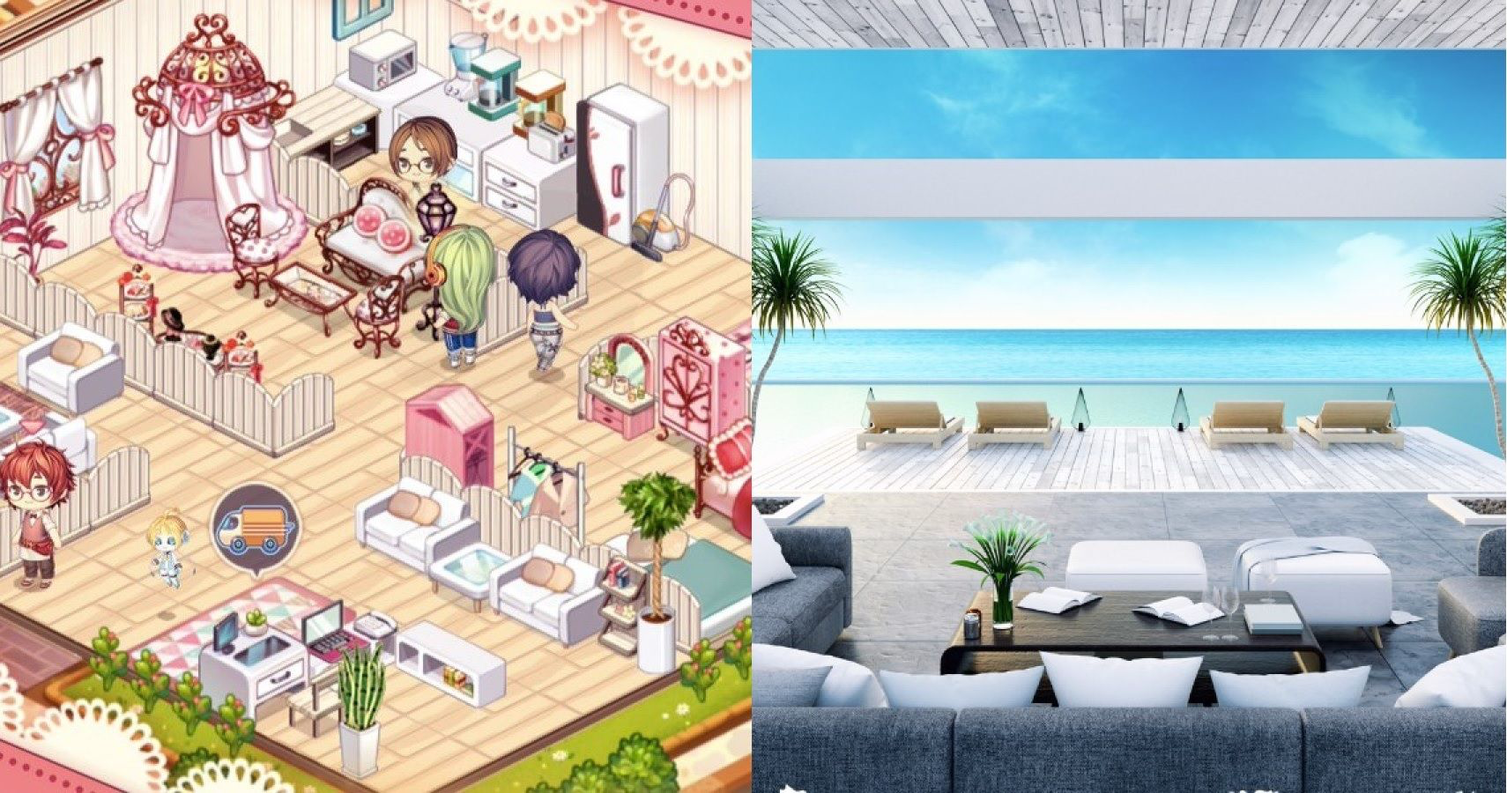
Name and their Contribution
Greater Care While Designing the Aesthetics of Adventure Rooms
Apply page animations and transitions to your Canva presentation to emphasize ideas and make them even more memorable.
Suggested UI Change #3

Slide 22
Summary
Task Flows
Crazy 8’s Rapid Prototyping. Tasks for users to understand, produce and engage with a language.
User Experience
Engaging, like real-life experiences, aesthetic, low stakes, positive words of affirmation
Next Steps
Pictures/Videos/Music, Organization, and Attention to Detail in Virtual Environments

Slide 23
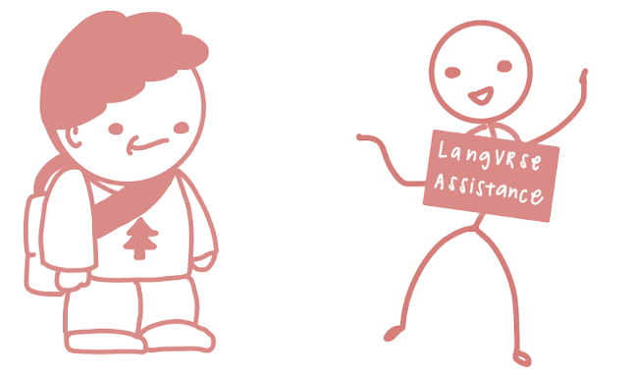
Thank you!
Do you have any questions for us?

